Slide 1


JavaScript Basics
Welcome Back!!!

Slide 2
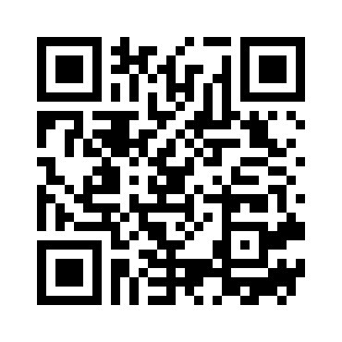
Please Scan it before we star

Slide 3

What is Javascript?
JavaScript is a high-level, versatile programming language primarily used for web development. It enables interactive and dynamic content on websites, making it a core technology of the web alongside HTML and CSS.

Slide 4

Syntax and Structure:
Variables: Declare variables using var, let, or const:
let name = "John";
const age = 30;
Data Types: JavaScript has dynamic types. Common types include String, Number, Boolean, Object, Array, null, and undefined
let isStudent = true;
let scores = [90, 85, 88];
Operators: Arithmetic (+, -, *, /), comparison (==, ===, !=, !==), logical (&&, ||, !), and more.
let sum = 10 + 5;
let isAdult = age >= 18;

Slide 5

Functions
Function Declaration: Define functions using the function keyword.
function greet(name) { return "Hello, " + name; }
Arrow Functions: A shorter syntax for writing functions.
const greet = (name) => "Hello, " + name;

Slide 6
Control Structures
Conditionals: if, else if, else, and switch statements.
if (age >= 18) { console.log("Adult"); } else { console.log("Minor"); }
Loops: for, while, and do...while loops.
for (let i = 0; i < 5; i++) { console.log(i); }
Objects and Arrays
Objects: Collections of key-value pairs.
let person = { name: "John", age: 30, isStudent: false };
Arrays: Ordered lists of values.
let fruits = ["Apple", "Banana", "Cherry"];

Slide 7

DOM Manipulation
It refers to interacting with and modifying a webpage’s Document Object Model (DOM) using JavaScript.
Selecting Elements: Use methods like getElementById, querySelector, etc.
let element = document.getElementById("myElement");
Modifying Elements: Change content, styles, and attributes.
element.textContent = "New Content"; element.style.color = "red";
Event Handling: Attach event listeners.
element.addEventListener("click", function() { alert("Element clicked!"); });

Slide 8
Asynchronous Programming
Callbacks: Functions passed as arguments to other functions.
setTimeout(function() { console.log("This runs after 2 seconds"); }, 2000);
Promises: Handle asynchronous operations.
fetch('https://api.example.com/data') .then(response => response.json()) .then(data => console.log(data)) .catch(error => console.error('Error:', error));
Async/Await: Syntactic sugar for promises.
async function fetchData() { try { let response = await fetch('https://api.example.com/data'); let data = await response.json(); console.log(data); } catch (error) { console.error('Error:', error); } }

Slide 9
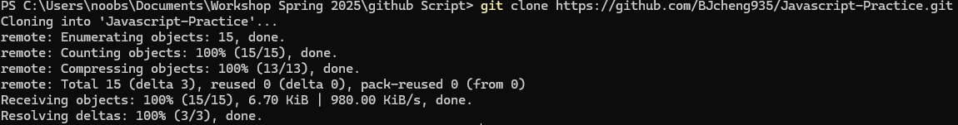
Let’s get some practice!!!
Create a new empty folder
Open you terminal and navigate until get to that new folder
Type this to download the files into that folder :
git clone https://github.com/BJcheng935/Javascript-Practice.git
You should get this:

Slide 10
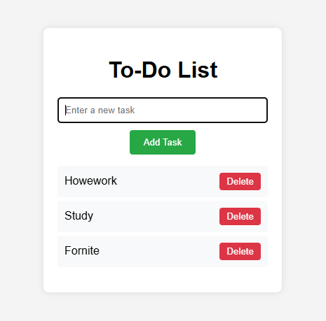
Here the example of the code working succesfully

Slide 11

Mine Tracker Attendance

